Slide 1
Artificial Intelligence
Feature Extraction I

Slide 2
Overview
New material: dealing with complex/unstructured data

Slide 3
Second term topics: details
Data exploration and preparation (1 week)
We need to add some of the basic bits we skipped last term
Evaluation (2 weeks)
Really important: we all need to know the important methods for establishing exactly how well our ML methods are performing
Feature extraction (2 weeks)
Really interesting topic: if our data doesn’t have a really obvious consistent structure (e.g., text documents, images) then how should we extract features
Support Vector Machines (2 weeks)
A final “black box” technique we think you should have some exposure to (e.g., visualising, tuning hyperparameters)
Then over to Deep Learning with Nick (3 weeks, not assessed)

Slide 4

[Lecture 2:] Machine learning in practice
Data collection
We will usually need to rely on databases/spreadsheets compiled by others
Data exploration and preparation
Browse the data, make sure it contains no obvious errors
Model training
Pass data to a suitable machine learning algorithm to train a model
Model evaluation
Test how well the model performs on unseen data
Model improvement
Can we make changes to the training process to improve performance
We’ve finished the recipe! On to other interesting things…

Slide 5


Slide 6
Last week’s reading
Hopefully you completed the reading on “bag of words”
Quite a lot of little steps…
(All possible in Matlab if you’re interested in text analysis…)
…But essentially we make a histogram over a common vocabulary
This gives us an equal number of features for each document, even though they may be completely different sizes
This is a really nice idea and used elsewhere for getting out features in other contexts where data is unstructured
E.g., images: “bag of visual words” (BOVW)
This is where we’re heading to over the next two lectures

Slide 7
Exam preparation questions
See for practice questions: they cover more ideas/methods, they’re getting a bit harder… But hopefully more interesting too…
…You might be asked to read through an example or watch a video first
…You might see new Matlab functionality that you need to roll with
E.g., the ImageDataStore object for easy handling of lots of (categories of) images
…You might see poor performance (e.g., ~60% accuracy) because we only use quite small (“toy”) datasets relative to the difficulty of the problems…
…But even so, some of the code will still be quite slow

Slide 8
Exam preparation questions
…You’ll also see a new (powerful) classifier
The call is to fitcecoc()
Creates a Support Vector Machine (SVM)
Don’t worry – we’ll talk about SVMs in upcoming lectures…
…But want us to start using them now for their good performance
You call fitcecoc() just like any other fitc*() function [no extra options]

Slide 9
Images are tricky
They’re rich with information about the world
Humans are brilliant at interpreting them…
…And so we feel it should be possible to get machines there too
But the information is high-dimensional and potentially very unstructured

Slide 10
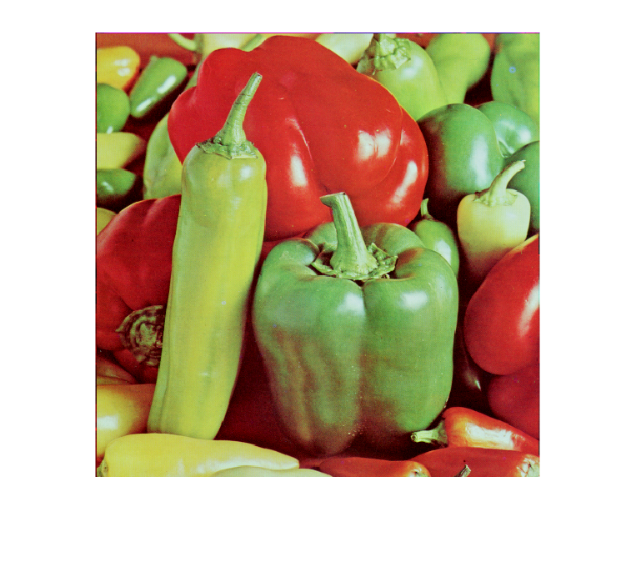
High dimensional
This image is 512*512
And there is a separate channel for every primary colour…

Slide 11
RGB colour channels
101 | 93 | 12 | 76 | 63
34 | 43 | 23 | 21 | 46
86 | 90 | 91 | 23 | 44
22 | 11 | 45 | 65 | 66
67 | 77 | 44 | 43 | 21
43 | 3 | 34 | 27 | 43
34 | 43 | 23 | 21 | 22
86 | 90 | 91 | 23 | 21
22 | 11 | 45 | 65 | 90
67 | 77 | 44 | 43 | 89
43 | 3 | 34 | 27 | 43
34 | 43 | 23 | 21 | 22
86 | 90 | 91 | 23 | 21
22 | 11 | 45 | 65 | 90
67 | 77 | 44 | 43 | 89
RGB images -> “red green blue images” -> “colour images”

Slide 12
High dimensional
Even if I just look at a little 8*8 square of colours in the top left hand corner…
I have 8*8*3=192 features (six times as many as the WISC data!)
Modern 4K images are 3840*2160…
“High-dimensional feature space”
Problems:
Classifiers can struggle to learn from high-dimensional data
Classifiers run slower with high-dimensional data
?

Slide 13
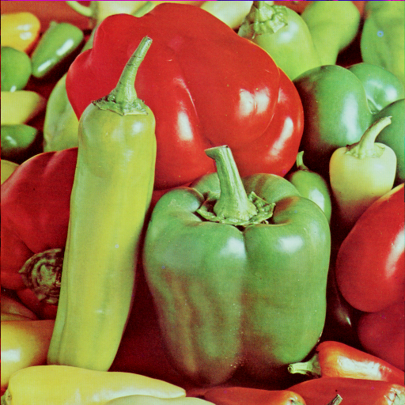
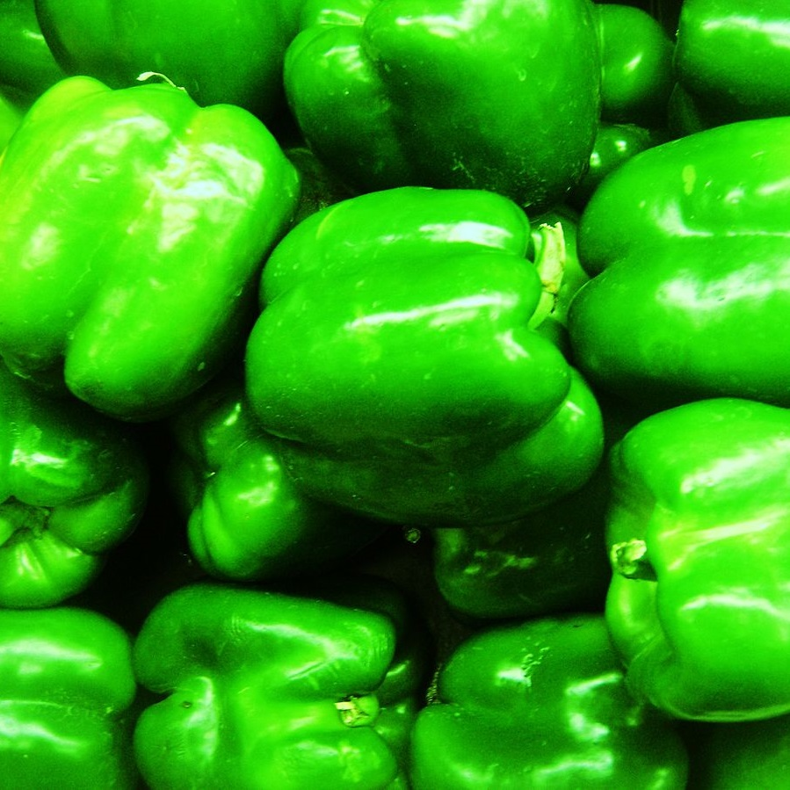
Unstructured
Image data is also very unstructured
I could have two images of the same thing…
But the patch I sample from the top left corner could look completely different
Based on natural variations in things like colour/shape/lighting/composition…
Problem:
Two raw images of the same thing could be very far apart in feature space

Slide 14
Implications
Big things for us to look at (two this week, rest next week):
Ways to summarise image data using fewer features
Ways to reduce the number of features you have generally
Finding distinctive image features
Finding commonly occurring distinctive features
(Ultimately: building a bag of visual words)

Slide 15
Representing image data
Patch-based representations are the most common approach – breaking the image down into many smaller regions (usually square)
Work with overall brightness levels, not specific colours
Try to identify structure within the patch
Extract a simplified (averaged) representation
Try to make the representation insensitive to commonly seen changes (e.g., illumination, scale, rotation)
E.g., we can spot the same patch in another image, if rotated by 90 degrees

Slide 16
Representing image data
There are lots of algorithms for extracting patch-based representations
HOG, SIFT, SURF, GLOH, BRISK, ORB, FREAK, FAST, …
They are complicated
Many were years in development and are patented…
It’s not our aim to learn all of the details of any of them…
…But to have some appreciation of basic/common ideas
…Be able to use at least one of them in Matlab (HOG)

Slide 17
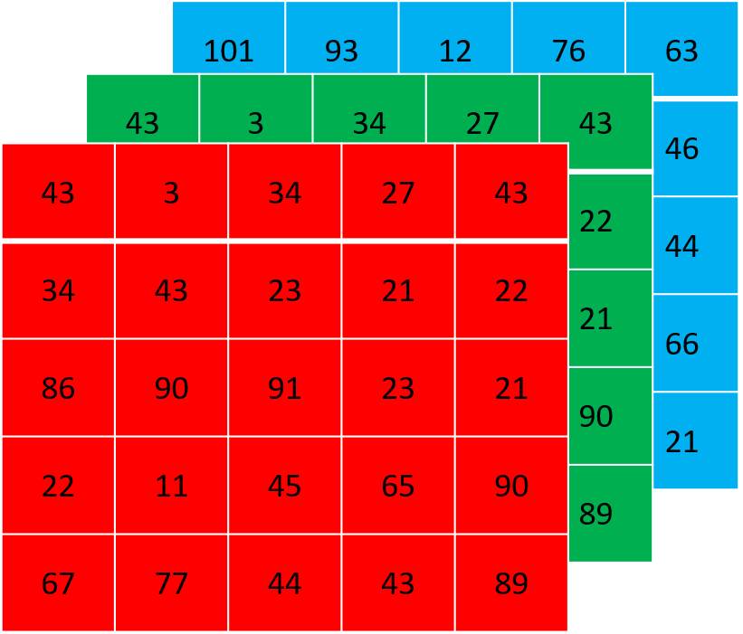
Colour to greyscale

Slide 18
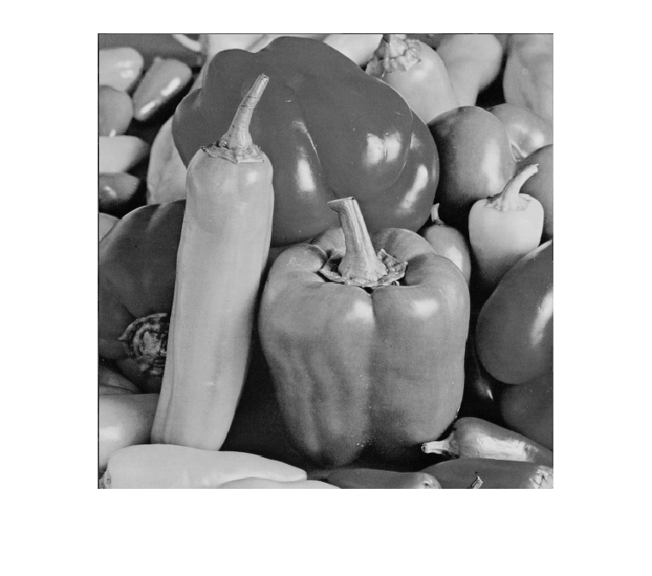
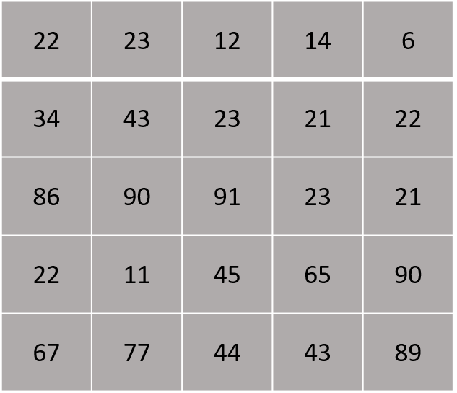
Colour to greyscale

Slide 19
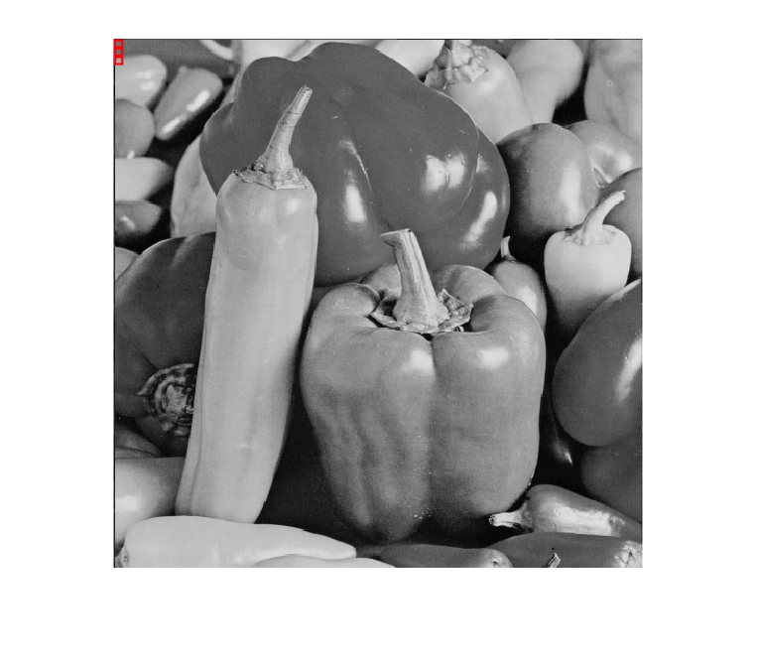
Divide up into equally sized patches
…
…

Slide 20
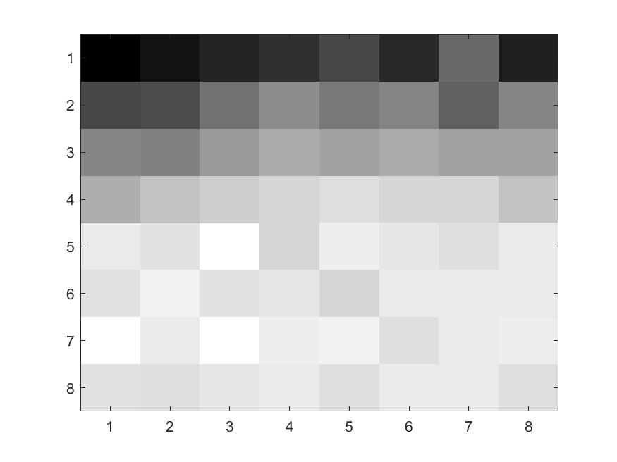
Let’s think about just one
…
…

Slide 21
These are the 64 grayscale values
0 = pure black; 255 = pure white

Slide 22
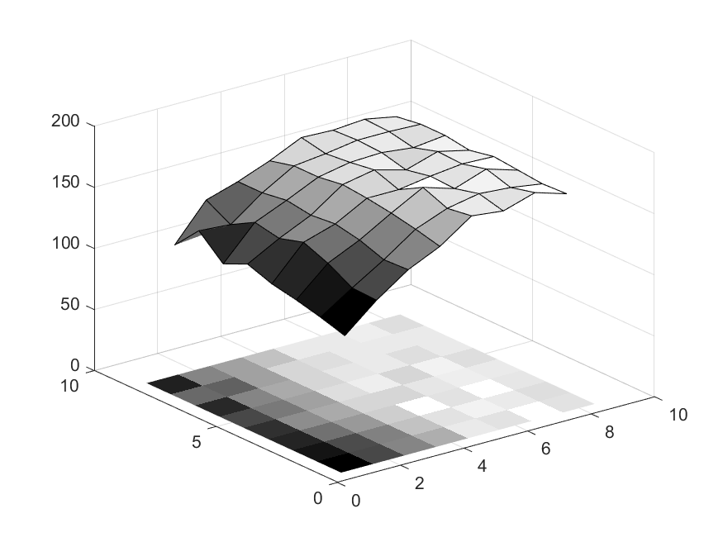
Pixel values as a surface
Height of each point equal to its brightness

Slide 23
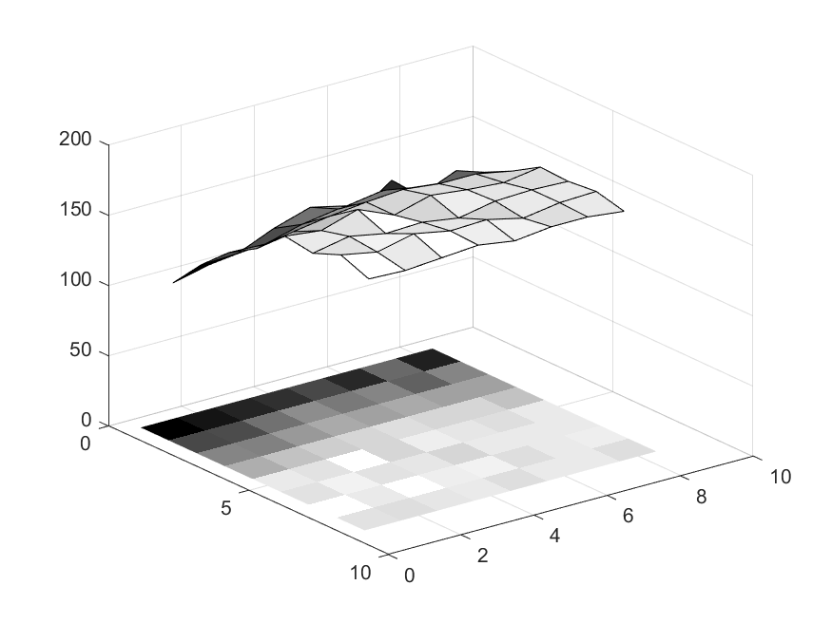
Pixel values as a surface (rotation 1)

Slide 24
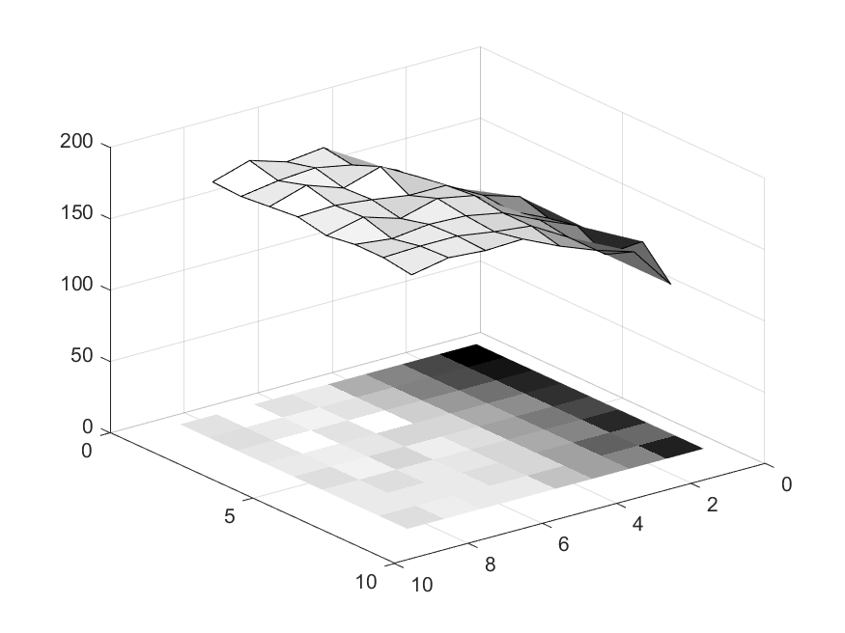
Pixel values as a surface (rotation 2)

Slide 25
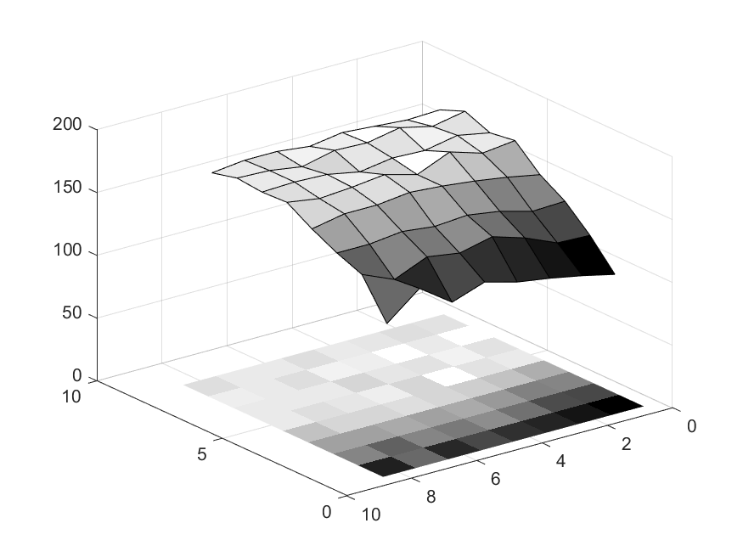
Pixel values as a surface (rotation 3)

Slide 26
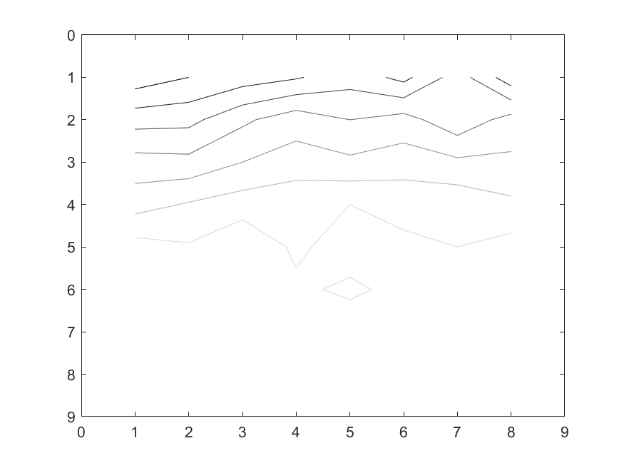
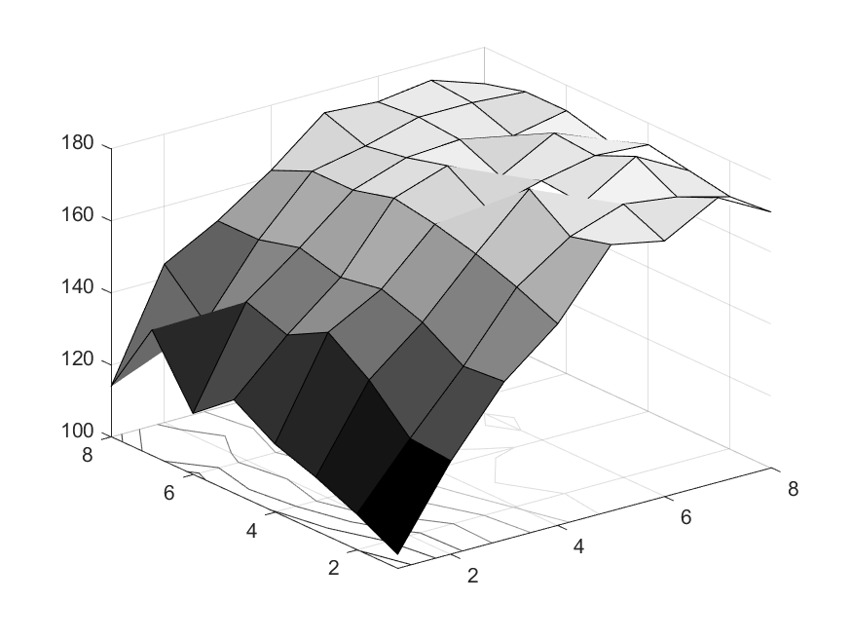
Surface structure as contours

Slide 27
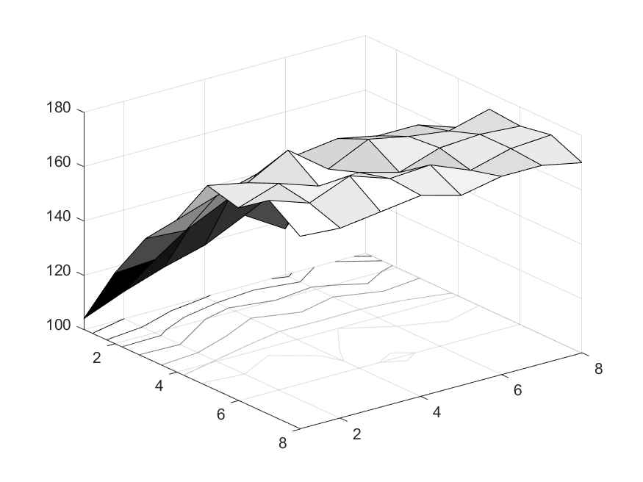
Surface structure as contours (rotation 1)

Slide 28
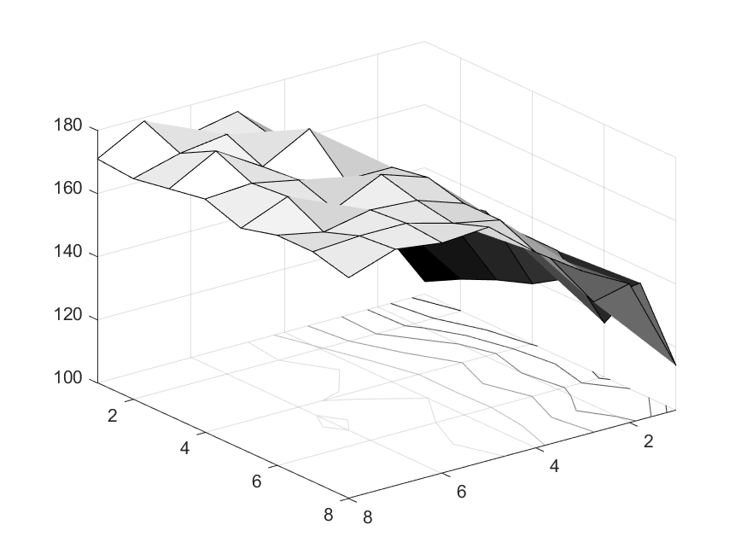
Surface structure as contours (rotation 2)

Slide 29
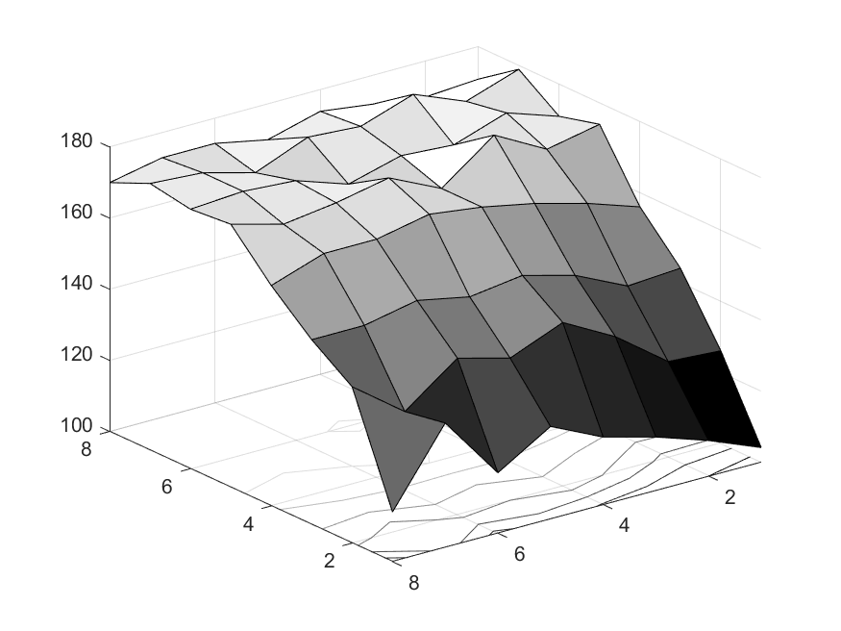
Surface structure as contours (rotation 3)

Slide 30
Local gradients run perpendicular to contours

Slide 31
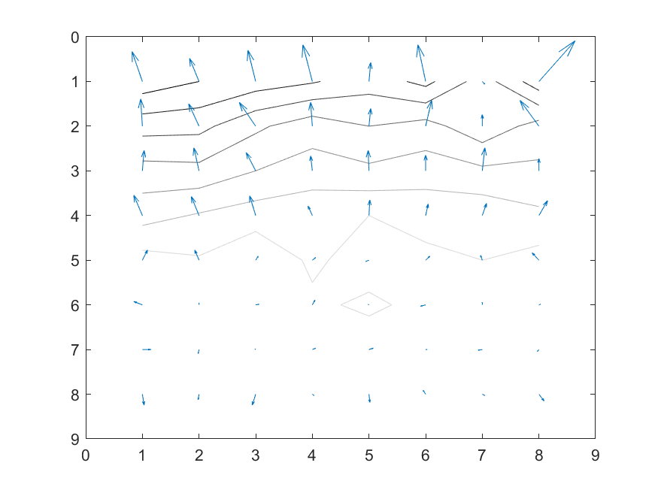
Local gradients run perpendicular to contours
If you dropped a ball at this point: which direction would it run and how fast

Slide 32
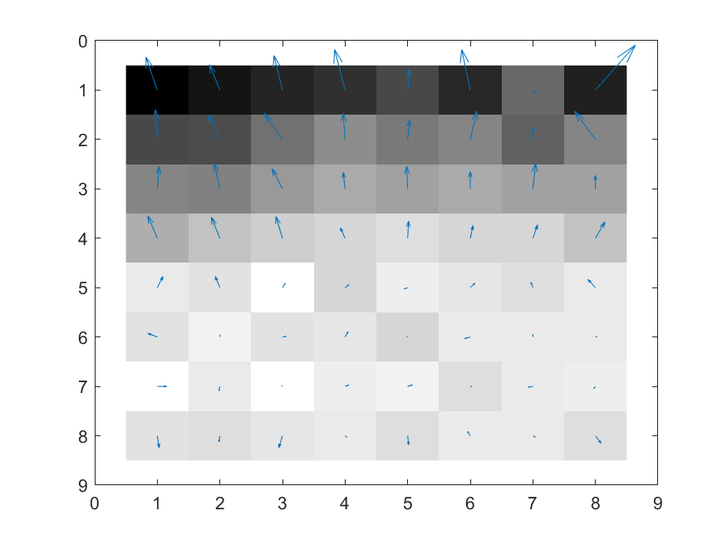
Local gradients plus pixels

Slide 33
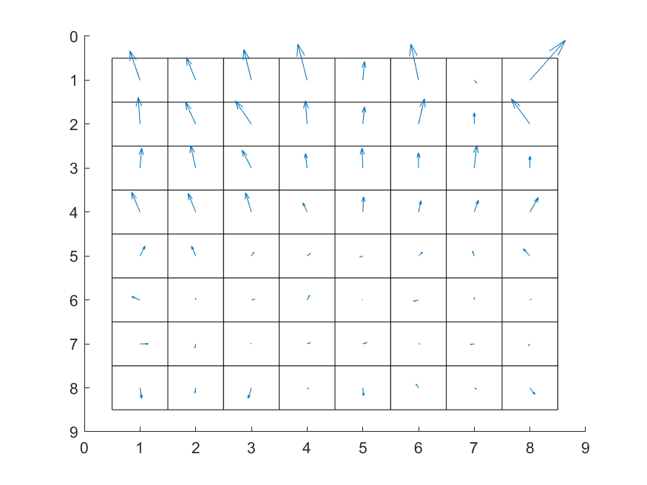
Local gradients without pixels

Slide 34
Local gradients
Pretty much all patch-based representations work with these local gradients (HOG, SIFT, …, etc.)
They all then try to compress them down into a more compact representation (e.g., averaging to give fewer numbers)…
And try to store them in such a way that they are insensitive to things like lighting changes (e.g., normalising gradients across patches)…
They each have a slightly different approach…
…But let’s look at a step that’s common to most

Slide 35
Build a histogram of oriented gradients

Slide 36
Build a histogram of oriented gradients
For each local gradient
Find the nearest bin and add one:

Slide 37
Build a histogram of oriented gradients
20
13
8
5
4
5
3
6

Slide 38
Build a histogram of oriented gradients
20
13
8
5
4
5
3
6
20 | 8 | 4 | 3 | 6 | 5 | 5 | 13
…

Slide 39
Build a histogram of oriented gradients
20
13
8
5
4
5
3
6
Your features:
20 | 8 | 4 | 3 | 6 | 5 | 5 | 13
…

Slide 40
HOG features
This idea is common to most patch-based feature representations
Exemplified in its simplest form by HOG features
HOG = Histogram of Oriented Gradients

Slide 41
Invariance
There are more than 8 features per patch in reality…
…Because HOG does other clever things to try and build invariance to things like illumination changes
…But it is a multiple of the number of bins in the histogram
Thinking of other forms of invariance…
…You can see that the circular histogram is well suited to coping with rotation
(same histogram, just slightly rotated)

Slide 42
HOG features in Matlab
See for practice questions: features = extractHOGFeatures(image) returns an array of features for a single image
Can call length(features) to see how big it is
This is equal to the dimensionality of your feature space
Depends on the patch size (or “cell size”) and you can find the default in the documentation…
…Or set your own patch size using the ‘CellSize’ option
As you do this, you change the dimensionality of your feature space…
…And the performance of your classifier

Slide 43
Visualisation
Can visualise a histogram of gradients with a “rose” plot
Centre the scores
Rotate through 90 degrees

Slide 44

HOG with CellSize=[8 8]
Total number of features = 142884

Slide 45

HOG with CellSize=[16 16]
Total number of features = 34596

Slide 46

HOG with CellSize=[32 32]
Total number of features = 8100

Slide 47

HOG with CellSize=[64 64]
Total number of features = 1764

Slide 48
Size of patch
Small patches
Pros: capture greater structural detail
Cons: higher-dimensional feature space; classifier can struggle to learn; slower performance
Large patches
Pros: lower-dimensional feature space; classifier won’t struggle to learn; faster performance
Cons: capture less structural detail
Need to strike a balance: we want enough detail, but not too much

Slide 49
Image classification: scenario 1
Simplest application of patch-based features
Not requiring complex approaches to invariance
But requiring tightly constrained problems
Images are the same size
Composition is the same (e.g., tightly cropped to object of interest)
Illumination reasonably consistent
We can reasonably make comparisons between corresponding patches in two images (top left, top right, bottom left, …)
E.g. passport photos
Main thing we need to consider: what patch size is appropriate?

Slide 50
(Next week)
Next week we’ll look at more unconstrained problems
Different sized images
Different compositions
Diverse object categories
Other objects present too

Slide 51
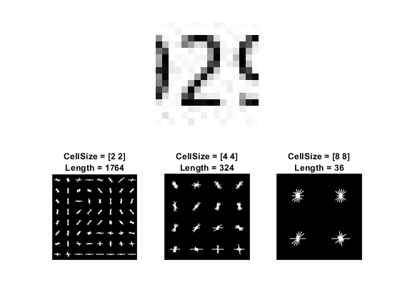
Scenario 1: a typical tradeoff
Representing hand-written characters:
“The visualization shows that a cell size of [8 8] does not encode much shape information, while a cell size of [2 2] encodes a lot of shape information but increases the dimensionality of the HOG feature vector significantly. A good compromise is a 4-by-4 cell size. This size setting encodes enough spatial information to visually identify a digit shape while limiting the number of dimensions in the HOG feature vector, which helps speed up training.” [link]

Slide 52
Scenario 1: measuring execution time
See for practice questions: you already know how to evaluate a classifier’s predictions, but what about execution times…
…You can measure how long code takes to execute with Matlab’s tic and toc functions:
tic; % start a timer
myfunction(); % do the things you want to time
time_taken = toc % stop the timer, and copy the time taken

Slide 53
Scenario 1: doing better
It would be nice if we could retain all the information we get with a cell size of [2 2]…
…But somehow reduce down the number of features we’re having to deal with…
Get 1764 down closer to 324
Decreases the chances our classifier will struggle to learn
Reduce execution times
Surely there is some redundancy in the data, enabling us to “throw away” bits of it…

Slide 54
Dimensionality reduction techniques
Completely general approach for any ML context (not just images)
You have lots of features
Classifier might be struggling to learn
Execution times might be unacceptable
Dimensionality reduction techniques will attempt to recover a completely new feature space, that contains fewer dimensions (fewer new features)…
…But still retains all (or most) of the information in your original feature space

Slide 55
Dimensionality reduction techniques
There are lots of dimensionality reduction techniques:
PCA, ICA, LLE, LDA, Isomap, GPLVM, …
They are complicated
It’s not our aim to learn all of the details of any of them…
…But to have some appreciation of basic/common ideas
…Be able to use at least one of them in Matlab (PCA)

Slide 56
Principal Components Analysis (PCA)
The basic idea…
Our examples trace out a shape in the feature space that is lower-dimensional than the feature space itself
If we could just pick up the axes of our feature space and carefully rotate them into a better position…
…Then we wouldn’t actually need every axis to describe the shape of our data
We could delete some of them without loosing any (or much) information about the shape

Slide 57

Principal Components Analysis (PCA)
Idea: our examples actually lie within a low-dimensional subspace of the full feature space
Idea: rotate our axes to better fit the distribution of examples and “delete” the unimportant dimensions
http://www.nlpca.org/pca_principal_component_analysis.html

Slide 58
Principal Components Analysis (PCA)
“Better fit”…
Want to retain as much of the original information in each feature as possible
The average amount of variation of each feature around its mean is a good measure of the amount of information it contains
Nicely measured by variance (similar to standard deviation)
Trick PCA uses is to look for features which co-vary
E.g., as this feature gets larger this one tends to get larger…
E.g., as this feature gets larger this one tends to get smaller…
Covariance is something you can compute (similar to variance)
Features with high covariance can be represented in a more compact way

Slide 59
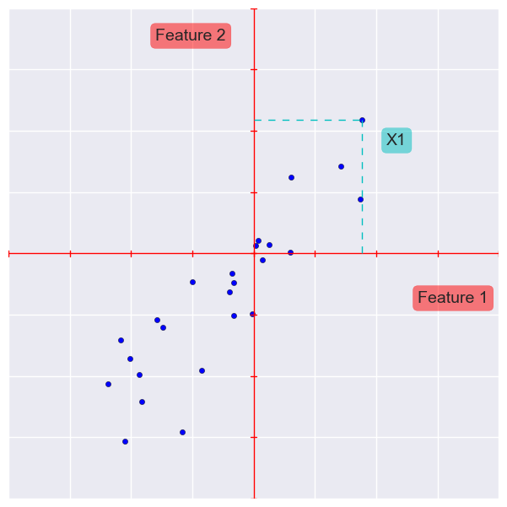
Normal plotting of data
We plot our data based on the features we have
X1 = (3.54, 4.35)
Meaning:
move 3.54 along Feature 1
move 4.35 along Feature 2

Slide 60
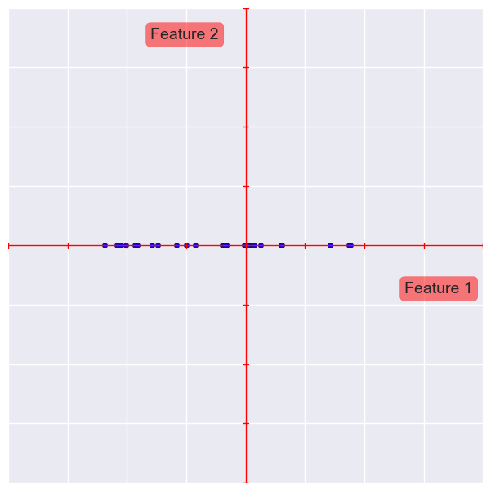
Throwing away features
Lost a lot of information

Slide 61
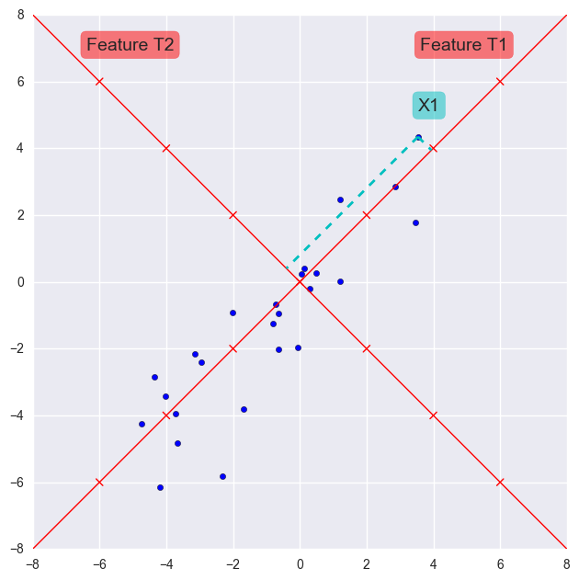
Create new features
We can plot the same data in terms of other features
X1 = (5.58, 0.57)
Meaning:
move 5.58 along Feature T1
move 0.57 along Feature T2

Slide 62
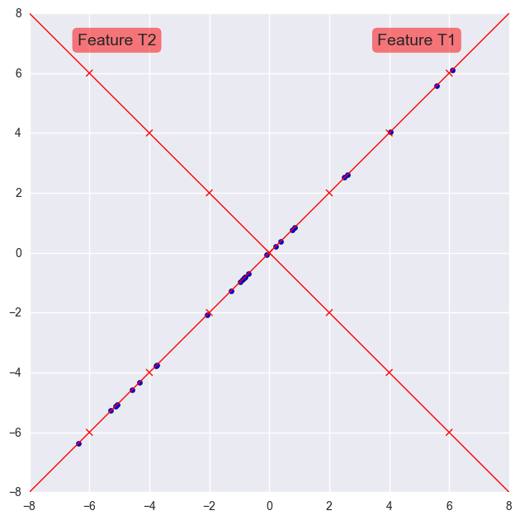
Throwing Away Features Now
Maintains most of the information

Slide 63
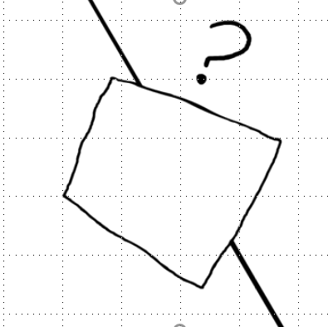
Principal Components Analysis (PCA)
Can think of your data as tracing out a fundamentally low-dimensional shape…
…Which is “stuck” inside a high-dimensional space
Physicist Carl Sagan’s “flatlanders” analogy can be useful when thinking about PCA for the first time: https://youtu.be/-wv0vxVRGMY
Like the flatlander lifted “up” into the third dimension:
Even if he is flipped around and spun about, we don’t really need 3 dimensions to describe him…
We just need to spin our 2 axes around to fit him
Or… useful interacive browser visualisation: http://setosa.io/ev/principal-component-analysis/

Slide 64
The principal components (PCs)
The new axes are called the Principal Components (PCs)
PCA is the process of finding those new axes
The PCs are ordered by the amount of information they contain
Actually, the fraction of the total variance in your original data
So the first PC contains the most information and is the most important…
…The last PC contains the least information and is the least important
See for practise questions: when deleting, start with the least important (last) PC and gradually move backwards – removing them in reverse order

Slide 65
You need to standardise
Similar issue to the one we had with k-NN
Variance and covariance depend on overall feature value magnitude
If you don’t standardise your feature values…
…Then information about important features could be lost simply because some features happened to have smaller values than others
See for practise questions: perform z-score standardisation on your data before you try to apply PCA
You can re-use code from the myknn class (fit) if you’re struggling to write it for yourself

Slide 66
PCA in Matlab
For the practice questions: Matlab’s pca() function will perform PCA on some data for you
[principal_components, data_transformed, ~, ~, explained] = pca(data)
data needs to be a normal matrix of feature values (not a table)
(remember: your features should be z-score normalised)
principal_components contains the new axes (the PCs)
data_transformed contains the coordinates of your examples in the new space (relative to the PCs)
explained contains the percentage of the total variance in your original data explained by each PC (will always run from high[most important] to low[least important])

Slide 67
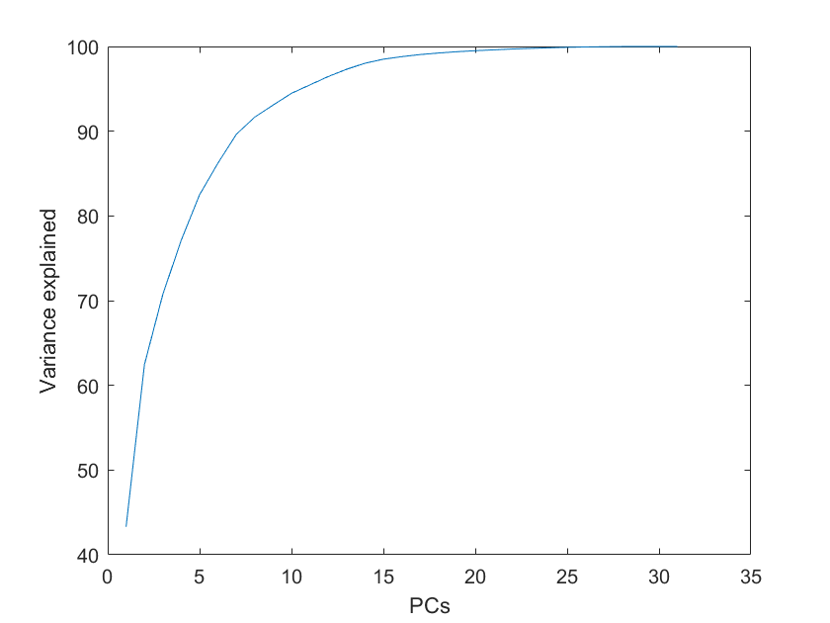
PCA in Matlab
For the practice questions: if you plot the cumulative sum of explained:
plot(cumsum(explained));
You can see how much of the total variance in the original dataset you are preserving, the more PCs you retain
Can help you decide how many to keep:
“I’ll keep the first 15 PCs in order to explain at least 95% of the variance in my training data”
You’ll need the datacursor…

Slide 68
PCA in Matlab
For the practice questions: data_transformed is a matrix with…
One row for every example (that you passed in to pca())
One column for every PC (giving coordinates for that axis)
So if you decide to retain only information about the first 15 PCs…
You would copy out a new dataset based on only the first 15 columns:
data_reduced = data_transformed(:, 1:1:15);
And you could use this to train a classifier…

Slide 69
PCA in Matlab
See for (harder) practice question: how do you get new data into your new space?
E.g., say you trained a classifier based on the first 15 PCs…
Now you have some new high-dimensional testing examples, containing the original feature values… examples_test
How do you get them into that same low-dimensional space?
So you can classify them
Three steps…

Slide 70
PCA in Matlab
Step 1: apply the same z-score normalisation transformation: see the fitcknn class (predict) if you need some help…
examples_test_standard
Step 2: then it’s just a simple matrix multiplication (no “dot” operator):
examples_test_new = examples_test_standard * principal_components;
Step 3: and retain only the coordinates for the PCs you’re working with (e.g., here we retain the first 15):
examples_test_reduced = examples_test_new(:,1:1:15);

Slide 71
Reading for next week
We’re working towards a bag-of-visual-words approach: this is a reading on a specific component (k-means) PLUS some more general big picture reading
Brett Lantz, “Machine Learning with R”
Chapter 9: “Finding groups of data – clustering with k-means”
Up to and including the section entitled: “Choosing the appropriate number of clusters”
Big picture (at least try the first one):
Google for “bag of visual words” and do some reading around
Have a look at Matlab (2018b) docs: https://uk.mathworks.com/help/vision/ug/image-classification-with-bag-of-visual-words.html [particularly the images]
Read the original paper: https://www.cs.cmu.edu/~efros/courses/LBMV07/Papers/csurka-eccv-04.pdf

